Slide 1

Disaster recovery with IBM cloud virtual servers

Slide 2
Phase 1
1.Problem definition
2.Design thinking

Slide 3
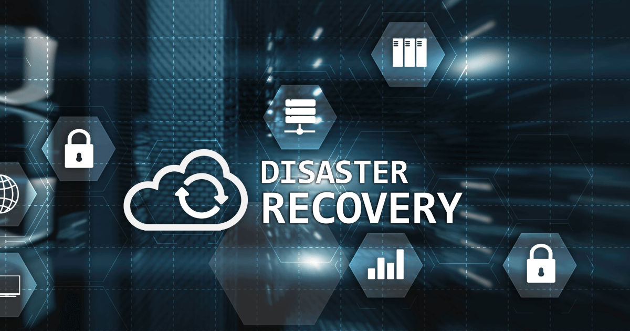
Introduction
Disaster recovery solutions make restoring your data and workloads easier so you can get business operations back online quickly after a catastrophic event. DR plans leverage data replication and often rely on automated recovery to minimize downtime and data loss.

Slide 4
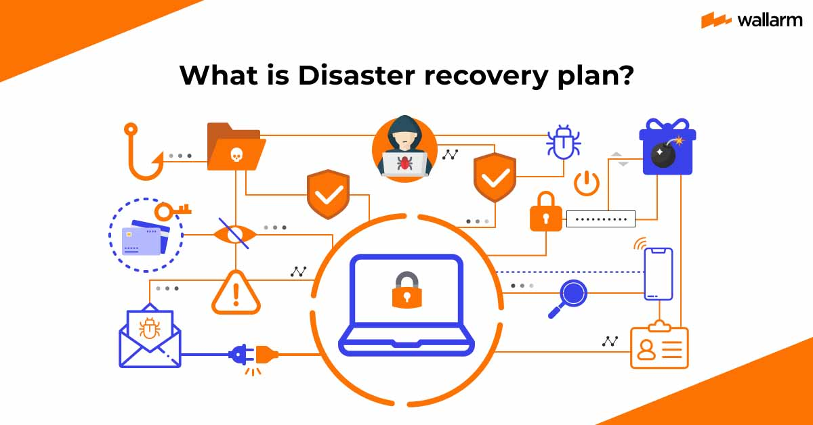

Slide 5

Disaster recovery (DR) typically refers to ability to restart IT services from a different geographic location and infrastructure. To implement DR, you need a set of data, compute, and network capabilities in the alternative location and the ability to operate and manage them.
Data can be continuously replicated or periodically refreshed. The time difference between the time of disaster and the age of the data images on the DR site is known as the recovery point objective (RPO). The recovery time objective (RTO) is the time to take the copies of data, associate compute and network, and reprovision the IT service from the alternative location.
Periodical DR testing is essential to maintain the ability to operate and manage the DR solution. To avoid impacting the protection (RPO) or the ability to recover (RTO) during a DR testing session, run the tests on a copied set of components.

Slide 6
1.Problem definition
Disaster recovery (DR) consists of IT technologies and best practices designed to prevent or minimize data loss and business disruption resulting from catastrophic events everything from equipment failures and localized power outages to cyberattacks, civil emergencies, criminal or military attacks, and natural disasters.
Many businesses especially small and midsized organizations neglect to develop a reliable, practicable disaster recovery plan. Without such a plan, they have little protection from the impact of significantly disruptive events.

Slide 7
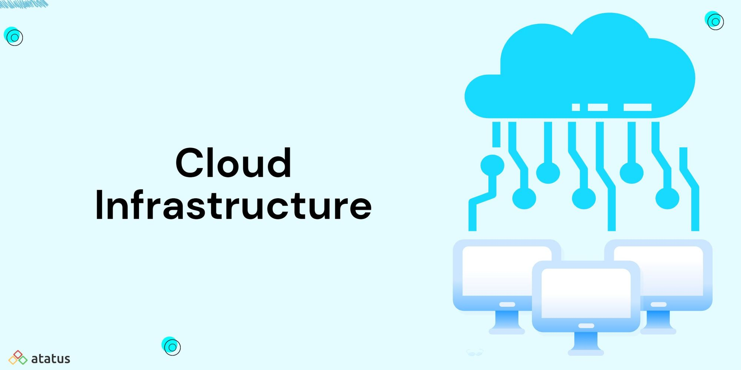
Infrastructure failure can cost as much as USD 100,000 per hour (link resides outside IBM), and critical application failure costs can range from USD 500,000 to USD 1 million per hour. Many businesses cannot recover from such losses. More than 40% of small businesses will not re-open after experiencing a disaster, and among those that do, an additional 25% will fail within the first year after the crisis. Disaster recovery planning can dramatically reduce these risks.

Slide 8
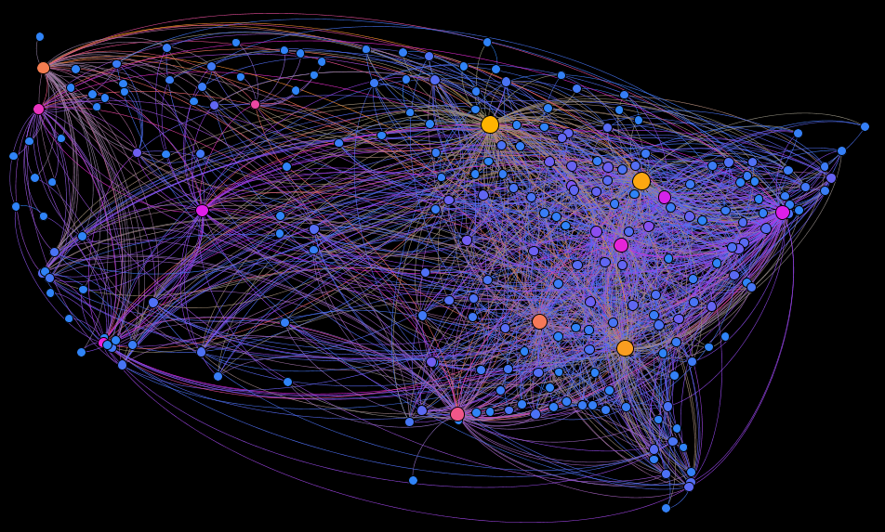
Virtualization
Virtualization is a great way to optimize your hardware resources and reduce costs, but it also introduces new risks and challenges for disaster recovery. If your virtual machines (VMs) or hosts fail, you could lose critical data and applications, disrupt your business operations, and damage your reputation. That's why you need a well-designed disaster recovery plan that covers all aspects of your virtualized hardware, from backup and replication to testing and restoration.

Slide 9
2.Design thinking
Disaster recovery planning involves strategizing, planning, deploying appropriate technology, and continuous testing. Maintaining backups of your data is a critical component of disaster recovery planning, but a backup and recovery process alone does not constitute a full disaster recovery plan.
Disaster recovery also involves ensuring that adequate storage and compute is available to maintain robust failover and failback procedures. Failover is the process of offloading workloads to backup systems so that production processes and end-user experiences are disrupted as little as possible. Failback involves switching back to the original primary systems.

Slide 10
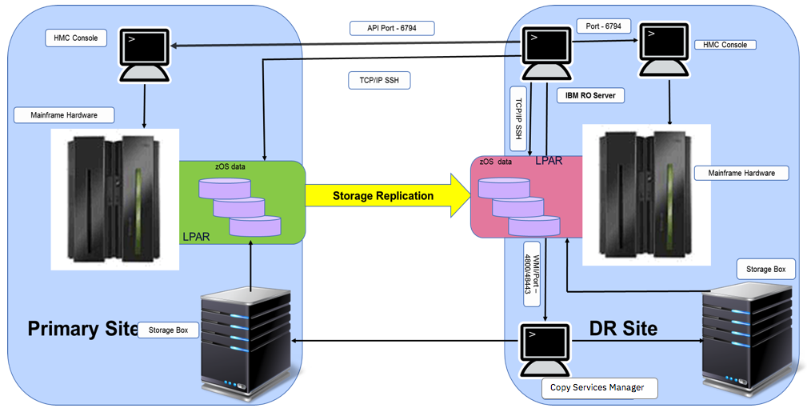

Slide 11
Design a disaster recovery plan for your virtualized hardware in six steps.
1.Assess your needs
The first step is to assess your needs and objectives for disaster recovery. You should identify the potential threats and scenarios that could affect your virtualized hardware, such as power outages, hardware failures, cyberattacks, or natural disasters. You should also determine the recovery point objective (RPO) and recovery time objective (RTO) for each VM and host, which are the maximum acceptable data loss and downtime in the event of a disaster. The RPO and RTO will help you prioritize the most critical VMs and hosts and choose the appropriate backup and recovery methods.

Slide 12
2.Choose your backup and replication methods
The second step is to choose your backup and replication methods for your virtualized hardware. Backup involves creating copies of your data and storing them in a separate location, while replication is the process of synchronizing your data and VMs across multiple hosts or sites. When selecting backup and replication methods, consider factors such as frequency, location, format, and encryption. Frequency depends on your RPO and the rate of data change; location could be on-site, off-site, or in the cloud; format could be full, incremental, or differential backups; and encryption could involve encryption keys, passwords, or certificates. All these factors should be taken into account according to your security, availability, budget requirements, RTO, storage capacity, compliance, and confidentiality standards.
3.Implement your backup and replication methods
The third step is to implement your backup and replication methods for your virtualized hardware. To do this, you should use tools and software that are compatible with your virtualization platform and support your backup and replication methods. Additionally, it's important to follow best practices when it comes to backups and replications. This includes scheduling backups or replications during off-peak hours, verifying them regularly to ensure they are complete and consistent, labeling and cataloging them to facilitate identification and retrieval, as well as monitoring them to detect and resolve any errors or failures.

Slide 13
4.Test your backup and recovery procedure
The fourth step is to test your backup and recovery procedures for your virtualized hardware. Testing is essential to ensure that your backup and recovery procedures work as expected and meet your RPO and RTO. You should test your backup and recovery procedures in a realistic and isolated environment, such as a sandbox or a test site, to avoid affecting your production environment. You should also test your backup and recovery procedures periodically and after any changes to your virtualized hardware, such as adding or removing VMs or hosts, or updating software or configurations.
5. Document your disaster recovery plan
The fifth step is to document your disaster recovery plan for your virtualized hardware. Documentation is important to provide clear and detailed instructions for your backup and recovery procedures, as well as roles and responsibilities, contact information, and escalation procedures. You should document your disaster recovery plan in a format that is easy to access and update, such as a digital file or a printed manual. You should also document your disaster recovery plan in a language that is understandable and consistent, using terms and acronyms that are familiar to your team and stakeholders.

Slide 14
6.Train your staff and stakeholders
The sixth and final step is to train your staff and stakeholders on your disaster recovery plan for your virtualized hardware. Training is crucial to ensure that your staff and stakeholders are aware and prepared for the potential disasters and their impacts, as well as the backup and recovery procedures and their roles and responsibilities. You should train your staff and stakeholders on a regular basis and after any changes to your disaster recovery plan, using methods such as workshops, simulations, or drills. You should also evaluate your training effectiveness and feedback, and make any necessary improvements to your disaster recovery plan or training program.

Slide 15


